Slide 1
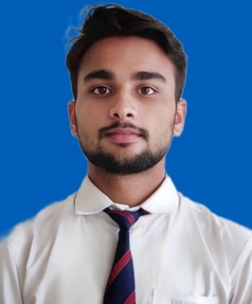
Rishabh Tripathi, Associate Consultant
    Background
    Rishabh is a data analyst with two years of experience in Data Analytics enabled digital transformation to analyze and creatively interpret data to provide organizations with effective solutions and assist with decision making. He had the opportunity to work with clients from diverse sectors, including Manufacturing, Healthcare, Telecom, Banking, and Retail. His expertise lies in utilizing technologies such as Python and SQL databases like MySQL, Postgres, and ClickhouseDB, as well as visualization tools like PowerBI and Apache Superset.
    Professional and Learning Experience
      Product Reporting using Apache Superset – Tanla Platforms Ltd (Onsite)
        Worked with industry leading CPaaS client to singlehandedly create reports and dashboards churning out insights from their flagship Anti-Phishing product thereby driving business KPIs and identifying critical flaws during the build stage of the product.
        Played a pivotal role in solidifying Apache Superset's position as a viable solution by taking the initiative to learn the platform from scratch, conducting extensive feature exploration and actively engaging with its creators and contributors developing engaging reports optimized for best user experience. Platform POCs were conducted with Vodafone-Idea, HDFC, ICICI and Kotak-Mahindra Bank.
        Single handedly designed data model and wrote SQL queries to process more than 30 million transactions per day.
      Procurement Process Reporting using PowerBI – Kirloskar Brothers Ltd. (Onsite)
        Utilised PowerBI as a visualization tool and SQL server as data warehouse for creating dashboards providing insights into Procurement process.
        Created data pipelines using Python for automation of data loading and transformation from FTP to SQL server.
      Revenue Assurance using Oracle – Axis Bank
        Executed KPIs for assessment of revenue leakage in various products/services offered by them like Credit Card, Merchant Discount Rates and Treasury.
        Used Oracle DB to write logics and evaluate KPIs in a time effective manner thereby facilitating client to take business decisions to minimize the revenue leakage.
      Audit process automation using Python - KGS
        Automated various audit processes using python for KGS’s IPA platform which can be accessed on a pay per use model.
        Used Pandas module in Python for importing excel files into dataframes and performing calculations as per the defined functional logic.
      Data Analytics using SQL – Alfa Laval Sweden
        Analyzed various risk and fraud related indicators on data using Postgres on defined parameters by the functional team.
        Effectively managed functional aspects of the process and handled client communication while working on technical aspects of the deliverable.
      Product management and UAT – Dr Reddy Labs
        Worked as an assistant product manager for development of full suite healthcare platform offering for doctor appointment, patient queries, medicine order and patient profiling.
        Performed User Acceptance Testing on the admin platform and API testing using GraphQL on APIs being consumed by the platform for onboarding stakeholders.
Rishabh Tripathi
KPMG India
rishabhtripathi1@kpmg.com
+91 8840454485
Function and Specialization
Data Analysis using Python & SQL.
Apache Superset and PowerBI.
Relational Databases – MySQL ,Postgres, Clickhouse, Oracle
DevOps tools (Docker, Jenkins, Git, Prometheus, etc.)
UAT, Jira and GraphQL API testing
Education, Licenses & Certifications
  Bachelors of Technology (CS)
  Hackerrank – 5 * in Python and Problem Solving.
Awards and Accolades
  Kudos – KPMG (March 2023)
  Rising Star – KPMG (Dec 2021)
  Achieved 1st rank in State Level Spell Bee

